Slide 1
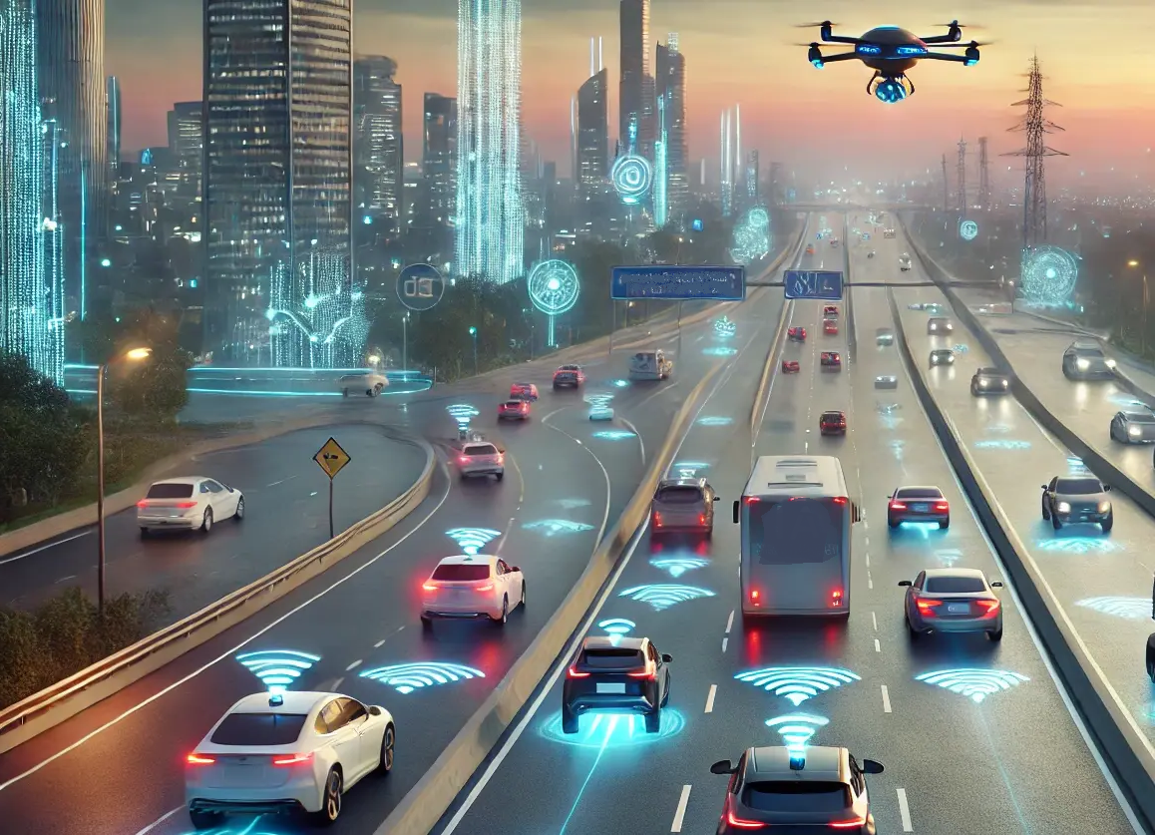

Capstone Project AI-Powered Road Accident Detection and Automated Rescue Alert System
GUIDED BY:
Prof. DR.Vijayaragavan
DR.S.K.Aruna
Presented by:
K.Tejaswi(192525407)
M.Nagashalini(192524183

Slide 2
Agenda
Introduction
Literature review
Objectives
Problem Statement
Traditional Accident Reporting Systems
Smart Accident Detection & Rescue Alert System
Circuit Diagram
Technologies used
Modules
Advantages
Conclusion
References

Slide 3

Introduction
Road accidents are a major cause of injuries and fatalities worldwide, affecting public safety and transportation systems.
Delayed accident reporting often prevents victims from receiving immediate medical assistance, increasing the risk of severe consequences.
Quick emergency response is essential to improve survival rates and reduce the impact of injuries.
Traditional reporting methods rely on victims or witnesses, which may not be possible during serious accidents.
The proposed system uses Artificial Intelligence (AI) and Python-based technologies to automatically detect accident events in real time.
Once an accident is detected, the system instantly sends alerts with location details to emergency services, enabling faster rescue operations and improving road safety.

Slide 4
LITERATURE REVIEW
SOURCE | AUTHORS | YEAR | KEY CONCEPTS | LIMITATION
CIRS: A Multi-Agent Machine Learning Framework for Real-Time Accident Detection and Emergency Response | Sadaf Ayesha et al. | 2025 | Uses machine learning and AI agents to detect accidents in real time and coordinate emergency response services. | Requires extensive training data and computational resources for accurate performance.
Smart Shield – Accident Detection and Alert System | P. Madhavi Latha et al. | 2024 | Employs GPS, GSM, and sensor technologies to automatically detect accidents and send emergency alerts. | Limited capability for accident severity assessment and verification.
IoT Based Automatic Vehicle Accident Detection and Rescue System | Raju Thommandru & Borugadda Swaroopa Ran | 2025 | Integrates IoT sensors with GPS and GSM modules for continuous vehicle monitoring and automated rescue notifications. | Performance depends on sensor reliability and network connectivity.

Slide 5

Objectives
Detect road accidents automatically using AI-based techniques.
Generate instant emergency alerts upon accident detection.
Share accurate accident location details with rescue services.
Store and manage accident records for future analysis.
Analyze accident data to identify trends and improve decision-making.
Enhance road safety by reducing rescue response time and improving emergency assistance.

Slide 6

Problem Statement
Emergency services often lack a mechanism to identify accidents immediately after they occur.
Critical information such as accident location and severity is not available in real time to rescue teams.
Manual monitoring of road incidents is inefficient and cannot cover all locations continuously.
Lack of automated communication between accident sites and emergency responders leads to operational delays.
Absence of centralized accident data collection makes it difficult to analyze patterns and improve road safety measures.
Therefore, there is a need for an intelligent system that can automatically detect accidents, assess the situation, and initiate rescue alerts without requiring human intervention.

Slide 7

Traditional Accident Reporting Systems
Accident information is often reported manually, leading to delays in emergency response.
Rescue teams may not receive accurate details about the accident location and severity.
Communication between accident sites and emergency services can be slow and inefficient.
Traditional systems lack continuous monitoring and instant accident detection capabilities.
Accident data is not effectively stored or analyzed for identifying safety trends and risk zones.
The absence of automation reduces the overall efficiency of rescue operations and road safety management.

Slide 8

Smart Accident Detection & Rescue Alert System
Uses Artificial Intelligence (AI) and sensor data to automatically identify road accidents without human intervention.
Continuously monitors vehicle conditions and surroundings through a real-time monitoring system.
Instantly generates emergency rescue alerts when an accident is detected, reducing response delays.
Automatically shares the exact accident location with emergency services and registered contacts using GPS.
Maintains a centralized database to store accident records for future analysis and decision-making.
Analyzes collected data to improve emergency response strategies, enhance road safety, and reduce accident-related casualties.

Slide 9
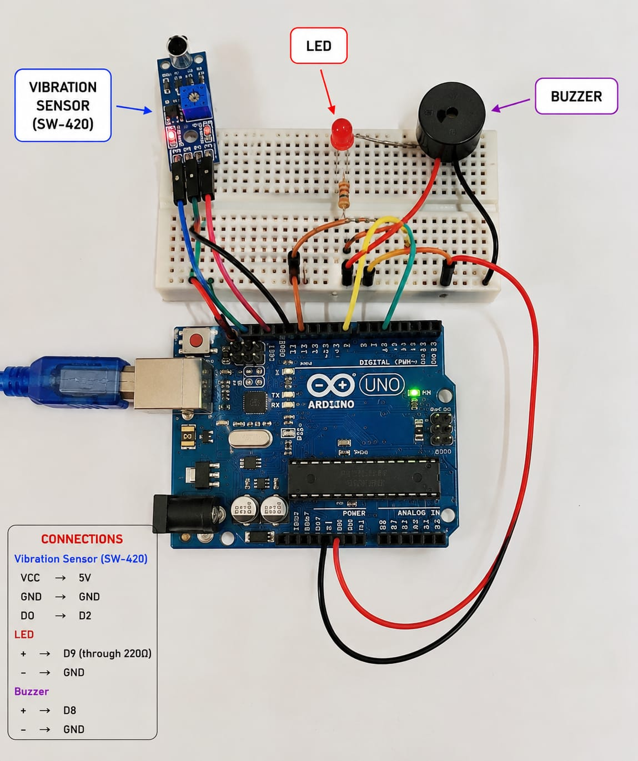
Circuit Diagram

Slide 10
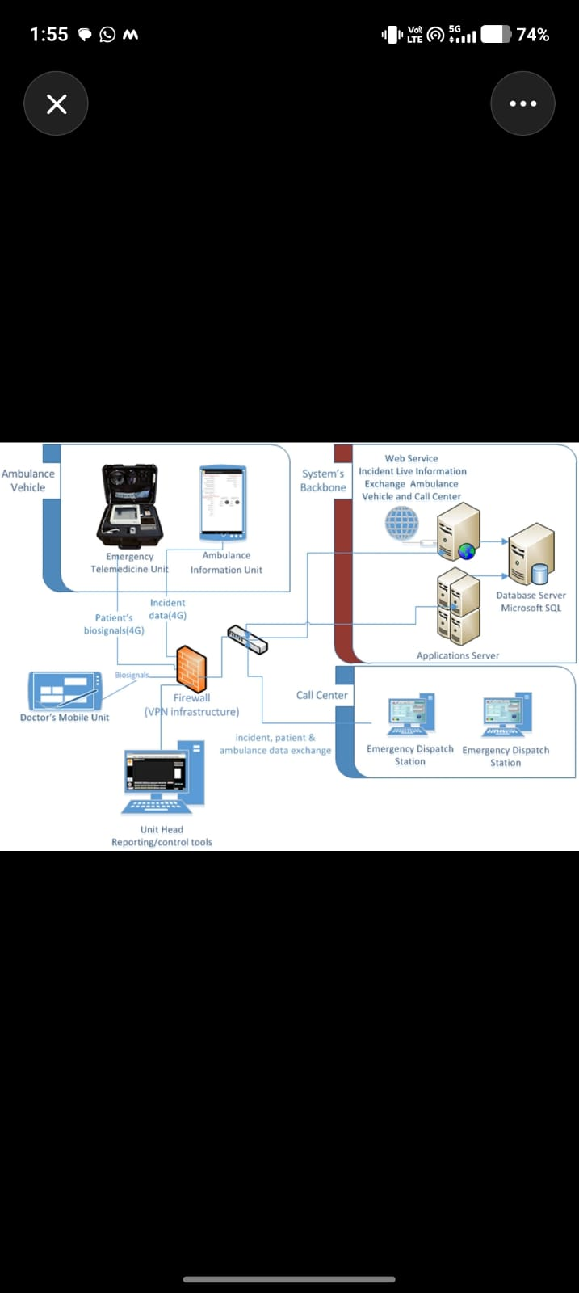
System Architecture
Vehicle/Sensor Data
↓
Python Processing
↓
AI Accident Detection
↓
Accident Confirmation
↓
Alert Generation
↓
GPS Location Sharing
↓
Emergency Services & Contacts
↓
Database Storage

Slide 11
Technologies Used
Python Programming – Used to develop the accident detection and alert system.
CSV File Processing – Stores and manages accident records and sensor data efficiently.
Data Analysis – Analyzes collected data to identify accident patterns and trends.
GPS Location Tracking – Determines and shares the exact accident location in real time.
Artificial Intelligence (AI) – Automatically detects accidents using intelligent algorithms.
Matplotlib & Pandas – Used for data visualization, reporting, and performance analysis.

Slide 12

Module 1 – AI-Based Accident Detection
Continuously monitors traffic using cameras and sensors placed on roads.
Detects accidents automatically by analyzing vehicle movements and collision patterns.
Identifies unusual events such as sudden stops, rollovers, or vehicle crashes.
Determines the severity of the accident based on the impact and damage indicators.
Records important information such as accident time and location.
Sends the detected accident details to the rescue alert system for immediate action.

Slide 13
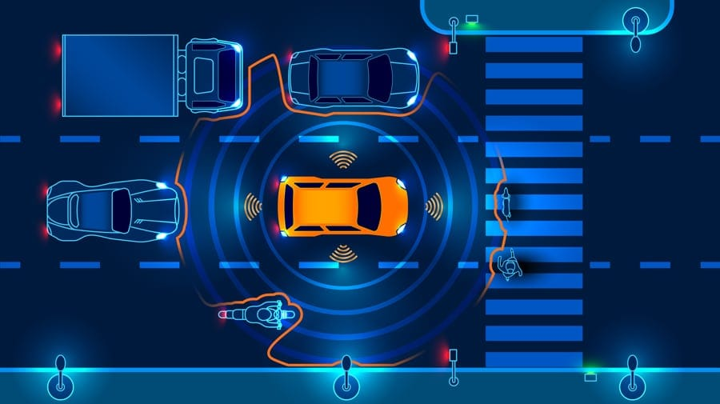
Module 2 – Automated Rescue Alert and Emergency Response
Receives accident information immediately after it is detected by the AI system.
Retrieves the exact accident location using GPS for accurate emergency assistance.
Automatically generates and sends alerts to nearby ambulance services, hospitals, and police stations.
Notifies the victim's registered emergency contacts through SMS or mobile notifications.
Provides real-time updates on rescue team dispatch and response status.
Ensures faster emergency response, reducing delays and improving victim safety.

Slide 14
Advantages
Provides fast and automatic accident detection.
Reduces emergency response time through instant alerts.
Shares accurate GPS location with rescue services.
Improves victim safety and survival chances.
Maintains accident records for future analysis.
Supports data-driven decision making for road safety improvements.

Slide 15
Conclusion
The proposed system effectively detects road accidents using AI and Python-based technologies.
Automated rescue alerts help emergency services respond quickly to accident situations.
GPS-based location sharing enables faster assistance and improves victim safety.
Accident data can be stored and analyzed to identify trends and improve road safety measures.
Overall, the system offers a reliable, efficient, and cost-effective solution for accident detection and emergency response.

Slide 16
References
Sadaf Ayesha, Aqsa Aslam, Muhammad Hassan Zaheer, and Muhammad Burhan Khan, "CIRS: A Multi-Agent Machine Learning Framework for Real-Time Accident Detection and Emergency Response," Sensors, vol. 25, no. 18, 2025. P. Madhavi Latha, T. Lakshmi Naveena, T. Kavya Sri, and P. Sujana, "Smart Shield – Accident Detection and Alert System," International Research Journal on Advanced Engineering Hub (IRJAEH), vol. 2, no. 9, pp. 2342–2348, 2024. Raju Thommandru and Borugadda Swaroopa Ran, "IoT Based Automatic Vehicle Accident Detection and Rescue System," International Journal for Modern Trends in Science and Technology, vol. 10, no. 3, pp. 94–99, 2025. "Automatic Accident Detection System Using IoT Compared to the Systems that a Traffic Centre Uses for Accident Detection," Procedia Computer Science, vol. 231, pp. 16–23, 2024.

